Slide 1


Text Mining
2
+
College of Computer Science And Information Technology
2
+

Slide 2
What is text mining?
Text mining is a component of data mining that deals specifically with unstructured text data. It involves the use of natural language processing (NLP) techniques to extract useful information and insights from large amounts of unstructured text data.
For instance:
Named Entity Recognition (NER): Identifying and classifying named entities such as people, organizations, and locations in text data.
Sentiment Analysis: Identifying and extracting the sentiment (e.g. positive, negative, neutral) of text data.
Text Summarization: Creating a condensed version of a text document that captures the main points.
Topic Modeling: Identifying the main topics present in a document or collection of documents.
Text Classification: Assigning predefined categories to text data

Slide 3
Conventional process of text mining
Gathering unstructured information from various sources accessible in various document organizations, for example, plain text, web pages, PDF records, etc.
Pre-processing and data cleansing tasks are performed to distinguish and eliminate inconsistency from the data. The data cleansing process makes sure to capture the genuine text, and it is performed to eliminate stop words stemming (the process of identifying the root of a certain word and indexing the data.
Processing and controlling tasks are applied to review and further clean the data set.
Pattern analysis is implemented in Management Information System.
Information processed in the above steps is utilized to extract important and applicable data for a powerful and convenient decision-making process and trend analysis.

Slide 4
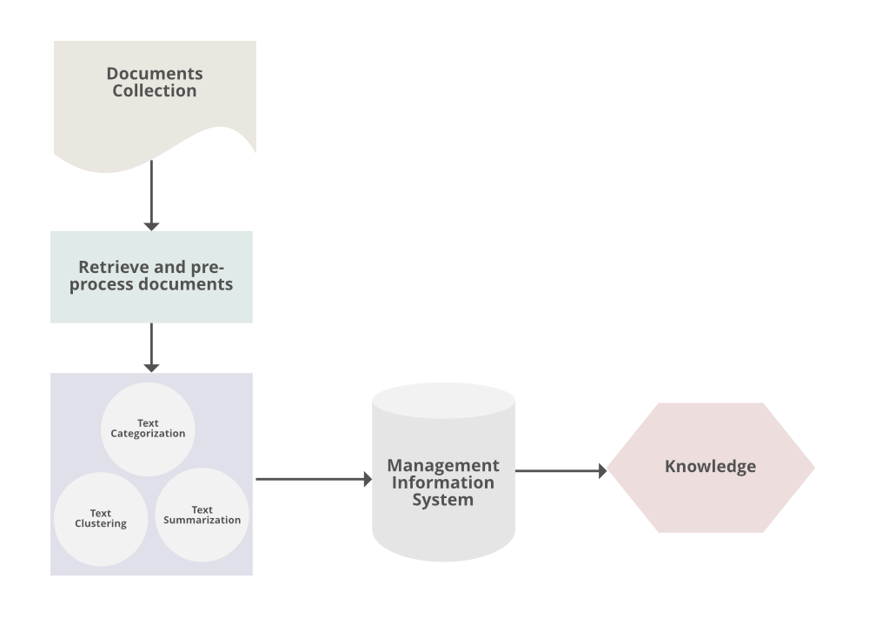
Procedures of analyzing Text Mining
Notes:
Text Summarization: To extract its partial content reflection its whole content automatically.
Text Categorization: To assign a category to the text among categories predefined by users.
Text Clustering: To segment texts into several clusters, depending on the substantial relevance.

Slide 5
Text Mining Techniques:
Information Extraction: It is a process of extract meaningful words from documents.
Information Retrieval: It is a process of extracting relevant and associated patterns according to a given set of words or text documents.
Natural Language Processing: It concerns the automatic processing and analysis of unstructured text information.
Clustering: It is an unsupervised learning process that grouping of text according to their similar characteristics.
Text Summarization: To extract its partial content reflection it’s whole content automatically.
geeksforgeeks

Slide 6
Text Mining Process Phase | Algorithm | Selected Question | Motive | Techniques
1. Text Preprocessing phase | Tokenization | How can transform a text into words or text format? | Transferring strings into a single textual token. | White space separation.
 | Compound word identification | How can I identify words that have a joint meaning? | Identifying words with a joint meaning that gets lost word | n-grms
 | Normalization and noise reduction | How can I cope with too many variables in my Document‐Term‐Matrix? | Reducing the dimensionality of Document‐Term‐Matrix | Stemming, Lemmatization, Deletion of stop words. infrequent term.
 | Linguistic analysis | How can I identify words with a special meaning or grammatical function? | Tagging of words | Named‐entity recognition, Part‐of‐speech tagging
2.Content Analysis | Dictionary‐based | How can I identify how latent sociological or psychological traits and states are reflected in natural language? | Measuring contextual, psychological, linguistic, or semantic concepts and constructs | pre‐defined dictionaries Customized dictionaries
 | Algorithmic techniques | How can I assign texts to predefined classes? | Classifying of textual entities into predefined categories | Supervised learning techniques such as binary or multi‐class classifiers
 | Clustring | How can I group together similar documents? | Clustering of textual entities into formerly undefined and unknown | Unsupervised learning techniques such as LDA, k‐means or non‐negative

Slide 7
Tokenization
Tokenization is the process of breaking down a text document into smaller units called tokens, which are usually words or subwords. This step is essential for various NLP tasks, including text analysis, sentiment analysis, and machine learning. Here’s how tokenization works:
Word Tokenization: This is the most common form of tokenization, where the text is split into individual words. For example, the sentence “Text mining is fascinating!” would be tokenized into [“Text”, “mining”, “is”, “fascinating”, “!”].
Sentence Tokenization: Sometimes, it’s necessary to split text into sentences. Sentence tokenization breaks a text into its constituent sentences. For example, “Text mining is fascinating! It can extract valuable insights from unstructured data.” would be tokenized into [“Text mining is fascinating!”, “It can extract valuable insights from unstructured data.”].

Slide 8
Steaming
Stemming is a text mining and natural language processing (NLP) technique used to reduce words to their root or base form. The purpose of stemming is to normalize words so that variations of a word are treated as the same word. For example, “jump,” “jumps,” “jumped,” and “jumping” would all be stemmed to “jump.”
Here’s how stemming works:
Word Reduction: Stemming algorithms work by removing prefixes or suffixes from words, ultimately reducing them to their root form. This process often involves heuristic rules rather than linguistic analysis.
Example: Using a simple stemming algorithm, the word “jumps” might be stemmed to “jump,” and “running” might be stemmed to “run.”
Normalization: Stemming helps with text analysis tasks where it’s beneficial to treat different inflections of a word as the same word, such as information retrieval or sentiment analysis.
It’s important to note that stemming is a more aggressive and less precise technique compared to lemmatization, which aims to reduce words to their grammatical root and considers the word’s context in the sentence. Stemming is faster and easier to implement but may not always produce valid words. The choice between stemming and lemmatization depends on the specific requirements of the NLP task.
There are various stemming algorithms available, such as the Porter Stemmer and Snowball Stemmer, which can be applied to different languages and domains.

Slide 9
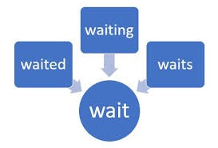
Example of steaming in text

Slide 10
Lemmatization
Lemmatization is a text mining and natural language processing (NLP) technique that goes beyond stemming to reduce words to their base or dictionary form, known as the “lemma.” The purpose of lemmatization is to normalize words while considering their grammatical and semantic context, resulting in valid words that make more sense.
Lemmatization Algorithm: Lemmatization algorithms use linguistic rules and dictionaries to determine the lemma of a word. These algorithms take into account the word’s part of speech, its context in the sentence, and its morphological variations.
Example: For the word “jumps,” lemmatization would correctly reduce it to “jump,” while for “running,” it would be reduced to “run.”
Semantic and Grammatical Accuracy: Lemmatization provides more semantically accurate results compared to stemming because it ensures that the resulting words are valid and meaningful in the language. It considers the word’s context and meaning within the sentence.
Context-Aware: Lemmatization is context-aware, which means that it considers the different meanings and usages of a word based on its grammatical role. For instance, “better” might be lemmatized to “good” (adjective) or “well” (adverb) depending on the context.

Slide 11
Stop words
In text mining and natural language processing (NLP), “stop words” refer to common words that are often filtered out or excluded from text data because they are considered to be of little value for analysis. These words are typically very frequent in a language and appear in many documents. Examples of stop words in English include “the,” “and,” “in,” “is,” “it,” “of,” “a,” and so on.
Here’s why stop words are removed in text mining:
Reducing Noise: Stop words add noise to the data and can make it harder to identify important terms or concepts. Removing them can improve the signal-to-noise ratio.
Efficiency: By excluding stop words, you reduce the size of the dataset, which can speed up text processing and analysis.
Focus on Keywords: Text mining often focuses on identifying keywords or significant terms in the data. Removing stop words helps in highlighting these keywords.
Memory and Storage: Stop words consume memory and storage space, and excluding them can be especially important in large-scale text analysis.

Slide 12
Example of removing stop word
Text = “My name is Ahmad, I live in Jazan”
Remove stop word:
[“name”, “Ahmad”, “live”, “Jazan”]
We still can get the meaning after removing stop words.

Slide 13
Part of speech tagging (POS)
Part-of-speech (POS) tagging, also known as speech tagging or word-category disambiguation, is a fundamental task in natural language processing (NLP). It involves the process of assigning a grammatical category or “part of speech” (e.g., noun, verb, adjective, adverb) to each word in a given text. POS tagging is crucial for understanding the structure and meaning of sentences, and it serves as a foundation for various NLP tasks.
Word Categorization: POS tagging categorizes words based on their grammatical roles and functions within a sentence. For example, it determines whether a word is a noun, verb, adjective, adverb, pronoun, conjunction, etc.
Context Dependency: The choice of a word’s part of speech can depend on its context in the sentence. For instance, “book” can be a noun (“I read a book”) or a verb (“Please book a table”).
POS Tags: Each part of speech is typically represented by a specific POS tag or label. Common POS tags include “NN” for nouns, “VB” for verbs, “JJ” for adjectives, “RB” for adverbs, and so on.
Applications: POS tagging is used in a wide range of NLP applications, including text analysis, information retrieval, machine translation, sentiment analysis, and named entity recognition.
Accuracy: Accurate POS tagging is essential for maintaining the grammatical structure and meaning of text, and it can significantly improve the performance of downstream NLP tasks.

